Slide 1
Linear regression
Given an input x we would like to compute an output y
For example:
- Predict height from age
- Predict Google’s price from Yahoo’s price
- Predict distance from wall from sensors
Y
X

Slide 2
Linear regression
Given an input x we would like to compute an output y
In linear regression we assume that y and x are related with the following equation:
y = wx+ε
where w is a parameter and ε represents measurement noise, model noise or other (data) noise
Y
What we are trying to predict
Observed values
X

Slide 4
Linear regression
Our goal is to estimate w from a training data of <x_{i},y_{i}> pairs
Optimization goal: minimize squared error (least squares):
Why least squares?
- minimizes squared distance between measurements and predicted line
- has a nice probabilistic interpretation (Gaussian Likelihood same as Mean Sq.)
- first degree polynomial model
Y
X

Slide 5
Multivariate regression
What if we have several inputs?
- Stock prices for Yahoo, Microsoft and Ebay for the Google prediction task
This becomes a multivariate regression problem
Again, its easy to model:
y = w₀ + w₁x₁+ … + w_{k}x_{k} + ε
Microsoft’s stock price
Google’s stock price
Yahoo’s stock price

Slide 6
Price of property = f ( Area, location, floor, ageing, amenities)
Y = a + b1 X1 + b2 X2
Where Y is the three-dimensional space, X1 & X2 are the predictor variables, b1 & b2 are referred as partial regression coefficients.

Slide 7
Assumptions in Regression Analysis
The dependent variable(Y) can be calculated as a linear function of a specific set of independent variables(X) and an error term(ϵ).
The number of observations(n) is greater than the number of parameters(k) to be estimated, ie n>k.
Regression line can be valid only over a limited range of data.
Variance is the same for all values of X.
The error term(ϵ) is normally distributed.
The values of the error term(ϵ) are independent and are not related to any values of X.
The OLS(Ordinary least square) estimator is the Best Linear Unbiased Estimator(BLUE) and this is called as Gauss-Markov Theorem.

Slide 8
Polynomial regression
Polynomial regression model is the extension of the simple linear model by adding extra predictors obtained by raising(squaring) each of the original predictors to a power.
If there are three variable, X, X², X³ are used as predictors.
F(x) = C₀ + C₁ X¹ + C₂ X² + C₃ X³

Slide 10
Let us use the below data set of (X, Y) for degree 3 polynomial
The regression line is slightly curved for degree = 3.
The regression line will curve further if we increase the polynomial degree.
Internal Exam(X) | 15 | 23 | 18 | 23 | 24 | 22 | 22 | 19 | 19 | 16 | 24 | 11 | 24 | 16 | 23
External Exam(Y) | 49 | 63 | 58 | 60 | 58 | 61 | 60 | 63 | 60 | 52 | 62 | 30 | 59 | 49 | 68

Slide 11
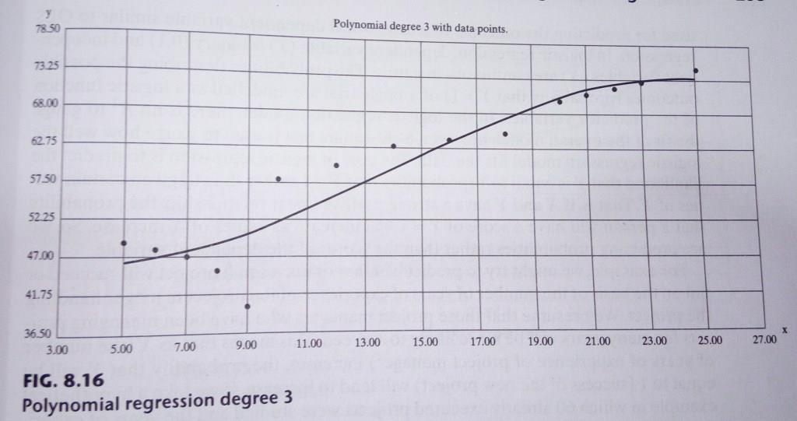

Slide 12
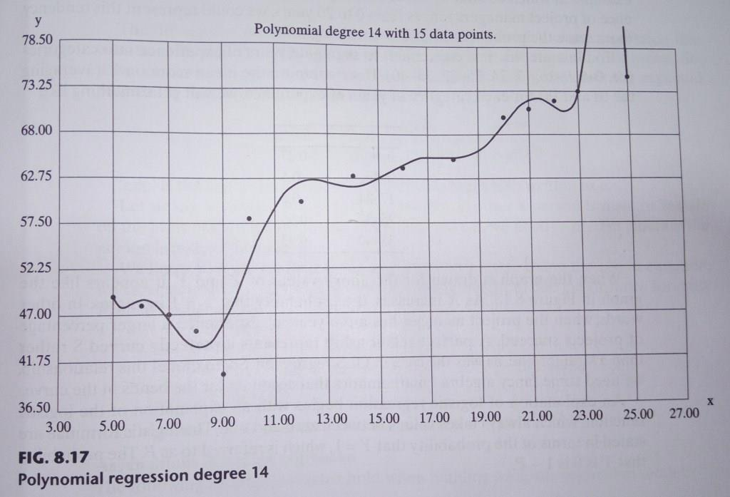

Slide 13
Logistic Regression
The logistic model is used to model the probability of a certain class or event existing such as pass/fail, win/lose, alive/dead or healthy/sick.
Logistic regression(LR) is a statistical model that in its basic form uses a logistic function to model a binary dependent variable.
It can be used for both Classification and Regression based on the given problem.
The goal of LR is to predict the likelihood that Y is equal to 1(probability that Y = 1 rather than 0) given certain values of X.

Slide 14
Example
We may predict the success or failure of a small project on the basis of the number of years of experience of the project manager handling the project.
This means that as X(the number of years of experience of manager) increases, the probability that Y will be equal to 1(success of project) will tend to increase.

Slide 15
Years of Experience | Probability of Success
0-8 | 0.27
9-16 | 0.5
17-24 | 0.6
25-32 | 0.66
33-40 | 0.93

Slide 16
END OF MODULE-2

